Slide 1
Building for Real Standards
Notes:
Today we’ll talk about building to standards and what that means in a
HTML5 world.

Slide 2
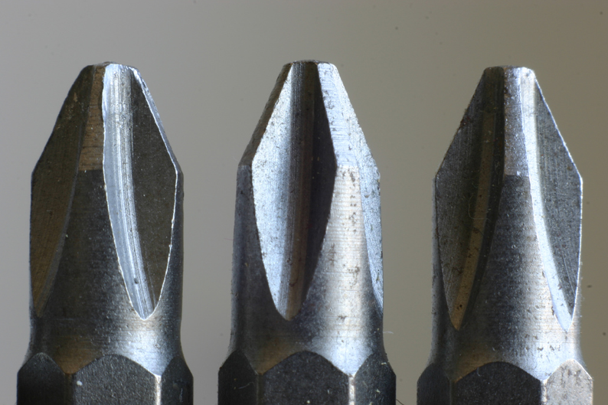
Standards, what are they good for, huh?
http://www.flickr.com/photos/grendelkhan/118876699/
Notes:
When the talk is about web development there can be a pushback from people claiming
that standards are falling behind and there is no need for them. A standard is nothing that
should hold you back, instead it should bring predictability to a certain trade or market.
Imagine a world where screws weren’t standardised the way they are - you’d need a
different tool to assemble and disassemble any piece of furniture or machinery. As it
stands, one type of screwdriver allows you to get very far and work with a massively
diverse range of materials.

Slide 3

It’s complicated...
Notes:
On the web this can get confusing as HTML5 is such a marketing term by now that
it is hard to find a standard to apply.

Slide 4
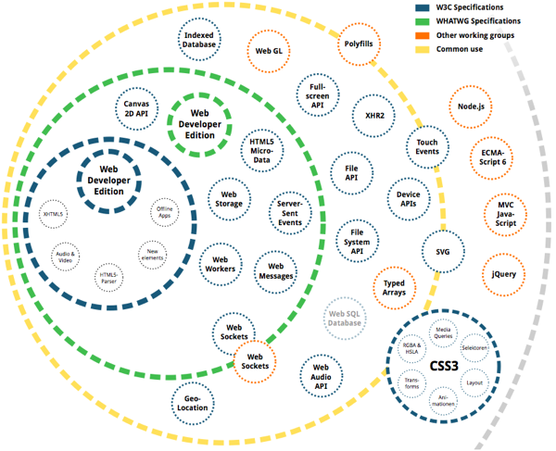
Notes:
This problem is exacerbated by the amount of standards that are not HTML5 but
always mentioned with it. This diagram shows just how confusing that can get. What
people call HTML5 is not it in most of the cases and both the W3C and the WHATWG have
“Web developer editions” of their proposals - meaning that a lot in the documentation
is actually aimed at browser/parser makers rather than web developers.

Slide 5
Everybody wants a piece of the action...
Desktop
Laptop
Mobile
Tablet
Fridge
...
Notes:
When we talk about HTML5 we should also always remember that the web moved on.
We don’t just build for Desktop machines where we can expect a certain resolution,
speed and connectivity. A large chunk of the HTML5 world means building solutions for
mobile devices.

Slide 6
Microsoft
Google
Mozilla
Opera
Apple
Adobe
Facebook
Twitter
...
Everybody has solutions to try out...
Notes:
A large part of the innovation around HTML5 happens not in the working group or
the WHATWG but comes directly from browser vendors and software companies.
All of these have vendor prefixes. This means that they can be great innovation that
can lead to a standard, but for now they are experimental and can change whilst
you apply them. Make sure to use them accordingly - with a fallback.

Slide 7
Demo time:
HTML5 basics
Notes:
Get the code examples on https://github.com/codepo8/buildingforrealstandards
and check the README for how to show them

Slide 8

Memo time:
Use what is needed - don’t TXTCODE
Safety goggles on!
Develop for the future
Build for the person who maintains your work.
Notes:
You can find more instructions how we reached these conclusions in the README
of the code examples.

Slide 9
Demo time:
Client side thumbnails?
Notes:
Get the code examples on
https://github.com/codepo8/buildingforrealstandards/canvasthumber and check
the README for how to show them

Slide 10
Memo time:
Browsers are powerful pieces of software
The client side rules!
Use what the client can do
Notes:
You can find more instructions how we reached these conclusions in the README
of the code examples.

Slide 11
Safety in production?
Notes:
As you can see HTML5 is incredibly powerful but also in flux. What you are excited about
today might not be available tomorrow. Therefore when you want to use HTML5 in
production you need to add some safe-guards.

Slide 12
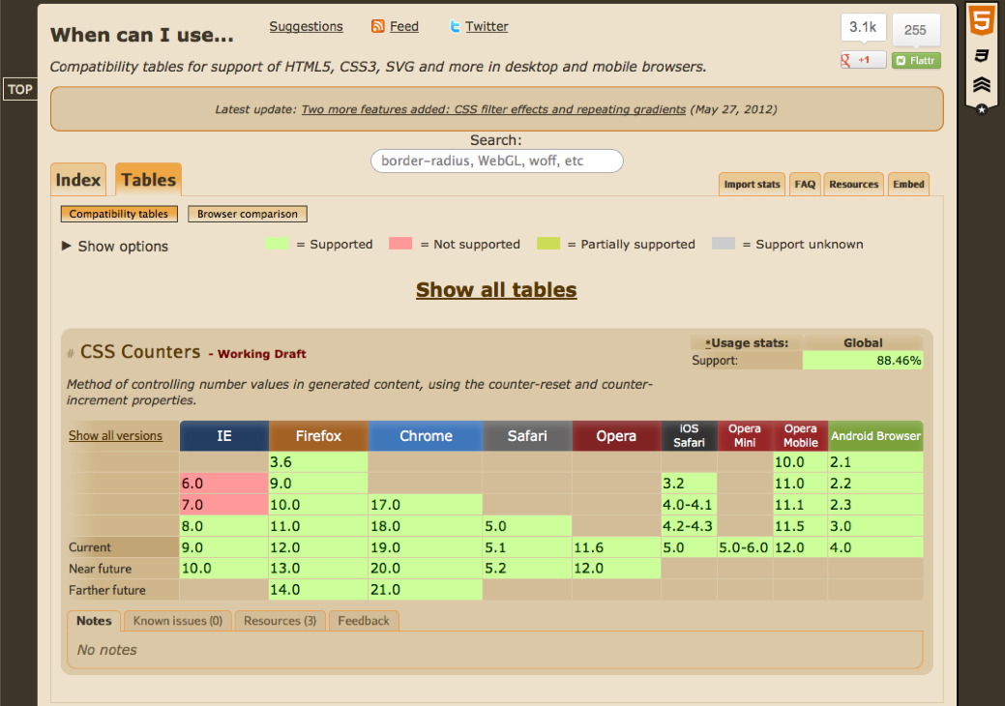
http://caniuse.com/
Notes:
Caniuse.com is a great resource to see how supported a certain HTML5 or CSS3 is
in the browsers your users are likely to be on. Simple, constantly updated tables
show you the current support in a very simple fashion.

Slide 13
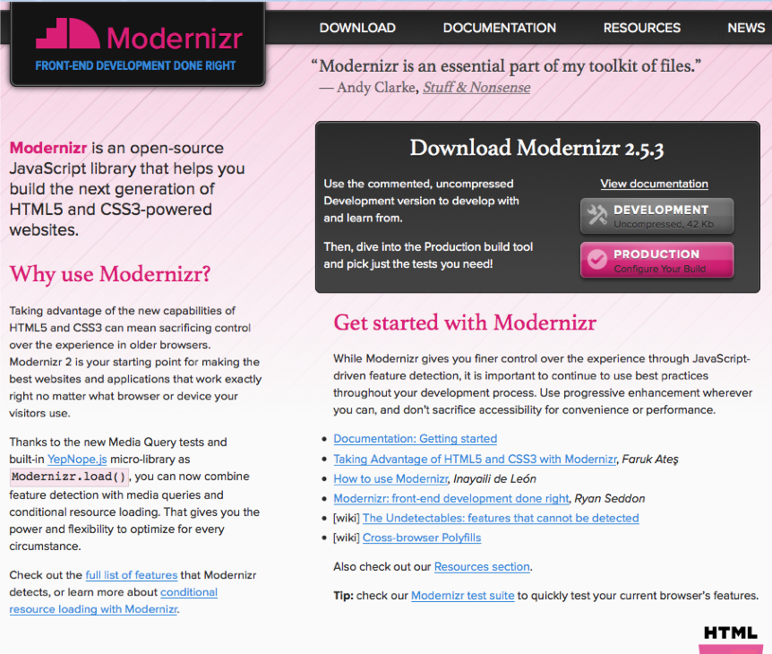
http://modernizr.com/
Notes:
Modernizr.com is a JavaScript library that makes feature detection easy. Instead of
knowing all the ins and outs of testing if the current setup supports @font-face for
example all you know is call the appropriate Modernizr function and you get a
Boolean back. Modernizr is used and supported by a lot of large web sites.

Slide 14
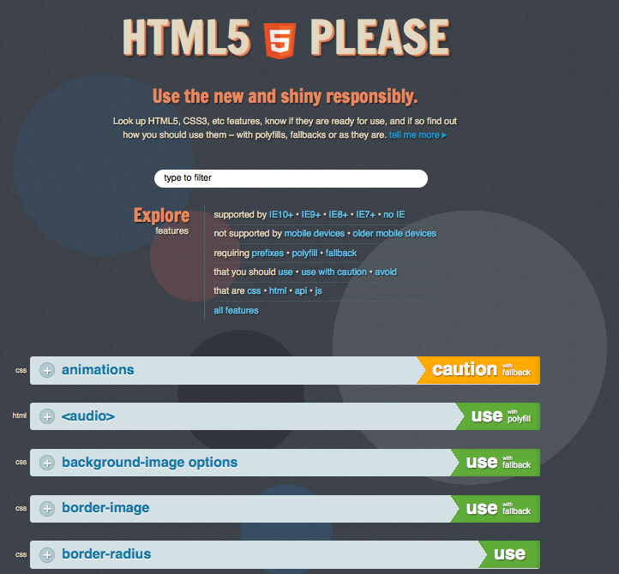
http://html5please.com/
Notes:
HTML5please.com is a web site powered by caniuse.com which shows you how safe it
is to use a certain new technology and gives you fallback examples and polyfill solutions
to bring missing functionality to legacy browsers.

Slide 15
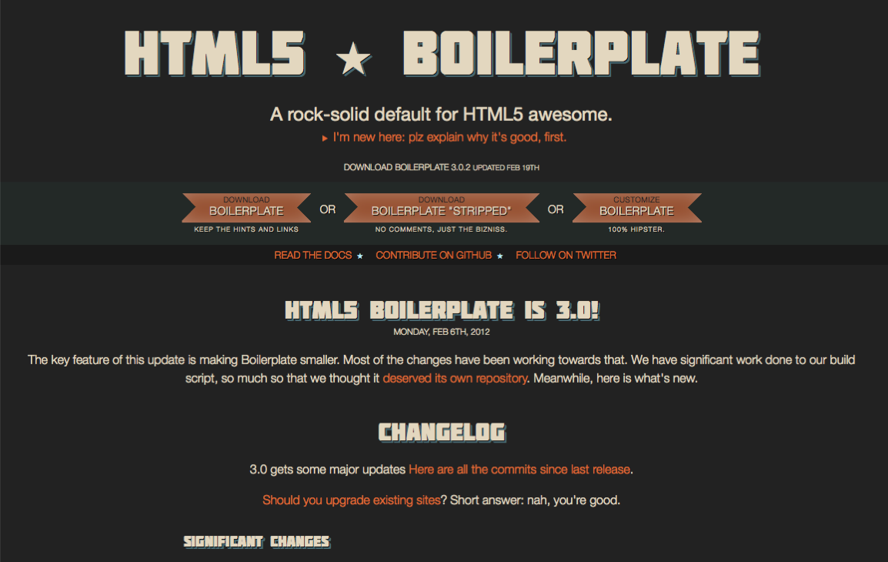
http://html5boilerplate.com/
Notes:
HTML5boilerplate.com is a great starting point for your next HTML5 project. Simply
download the zip of the boilerplate, unpack it and edit the index.html. Boilerplate
includes a lot of fixes for legacy browsers to make your product work across the board.

Slide 16
Do you want to know more?
Notes:
If you want to know more about all of this, don’t wait for the right book to be sold or
training to come to your town. Up-to-date information is available for free on the web,
and - even more importantly - we need your input!

Slide 17
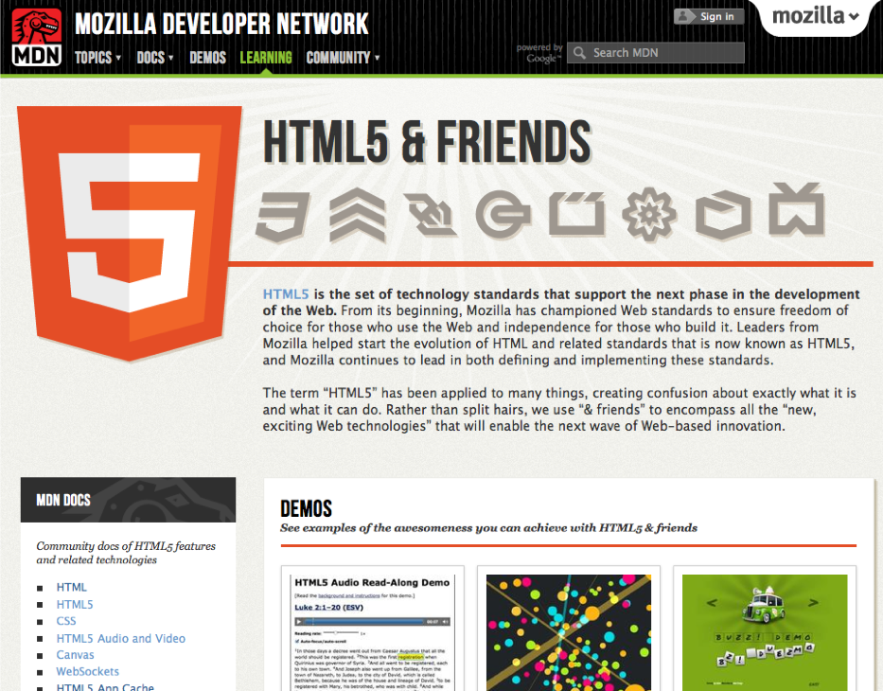
https://developer.mozilla.org/en-US/learn/html5
Notes:
At https://developer.mozilla.org/en-US/learn/html5 the Mozilla Developer Network
collects a lot of information on “HTML5 and friends” (related technologies like CSS, Web
Storage and the like). This documentation is written both my Mozilla experts and
Google guest authors and the best about it is that it is a Wiki - so if you have something
to add or you find a mistake, just edit it and we’ll review it for you.

Slide 18
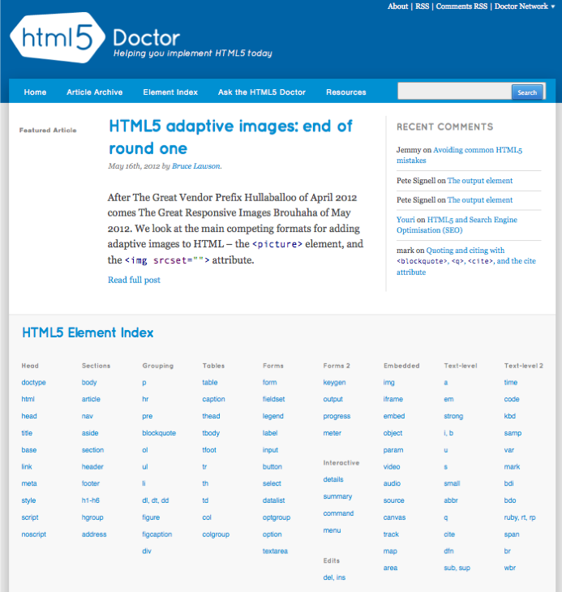
http://html5doctor.com
Notes:
HTML5doctor.com is a blog dedicated to explaining one HTML5 feature at a time
including all the issues with them and how to use them.

Slide 19
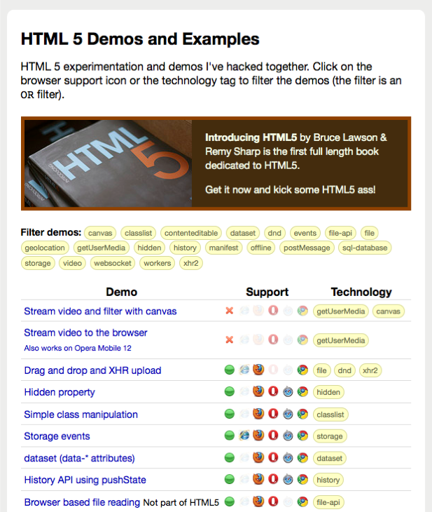
http://html5demos.com/
Notes:
HTML5demos.com is a showcase of HTML5 demos started by Remy Sharp, co-author
of “Introducing HTML5” - a great book to get you started with the subject matter.
These demos both show the basics and the bleeding edge of HTML with a legend on
which browsers are supported in them.

Slide 20
Last words (not famous).
Notes:
All in all it is important to understand that HTML5 is an evolution in the making. It is a
living and changing standard and works very closely with other technologies. Therefore
it is important to keep your eyes open and help us make it happen by filing browser bugs
and comment on what we do.

Slide 21
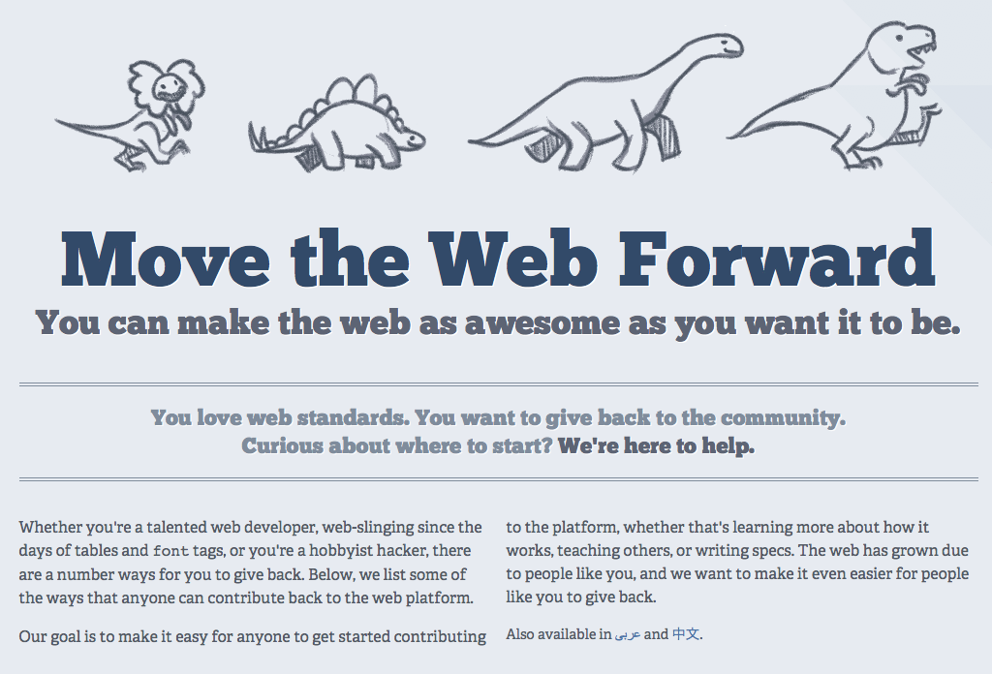
http://movethewebforward.org/
Notes:
movethewebforward.org is a great site explaining how you can give back to the
community that formed around web standards and how you can be part of a brighter
future for web developers and users of web technology - on the web and in apps.
Thank you!

